Slide 1
BOOSTING ALGORITHM

Slide 2
BOOSTING ALGORITHM
Boosting is a powerful ensemble technique that focuses on training models sequentially, where every new model attemps to correct the error.
Boosting converts a set of "weak learners" (usually shallow decision trees) into a single "strong learner".
It works by assigning higher weights to observations that were misclassified by the previous model.
OBJECTIVE: Primary goal is to reduce residual error(Difference between predicted and actual values)

Slide 3
ADA BOOSTING (ADAPTIVE BOOSTING)
AdaBoost is an ensemble technique that combines several weak models in sequence to create a strong one.
It creates decision stumps(Trees with only one split)
It assigns equal weight initially to all training samples and then adjust the weights.
After each tree is built it increases the weights of the incorrectly predicted samples
It effectively reduces bias and variance but sensitive to noisy data and outliers

Slide 4
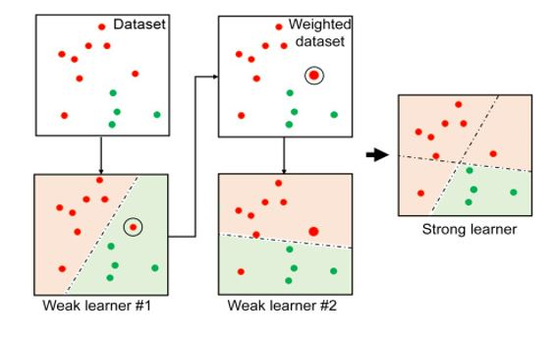
ADA BOOST

Slide 5
XG BOOSTING(EXTREME GRADIENT BOOSTING)
XG Boosting is optimized version of gradient boosting optimized speed, efficiency and accuracy
XGBoost uses decision trees as its base learners and combines them sequentially to improve the model’s performance.
Each new tree is trained to correct the errors made by the previous tree and this process is called boosting.
It is unique because it includes L1 (Lasso) and L2 (Ridge) regularization, which prevents the model from "over-guessing" or overfitting the training data.

Slide 6
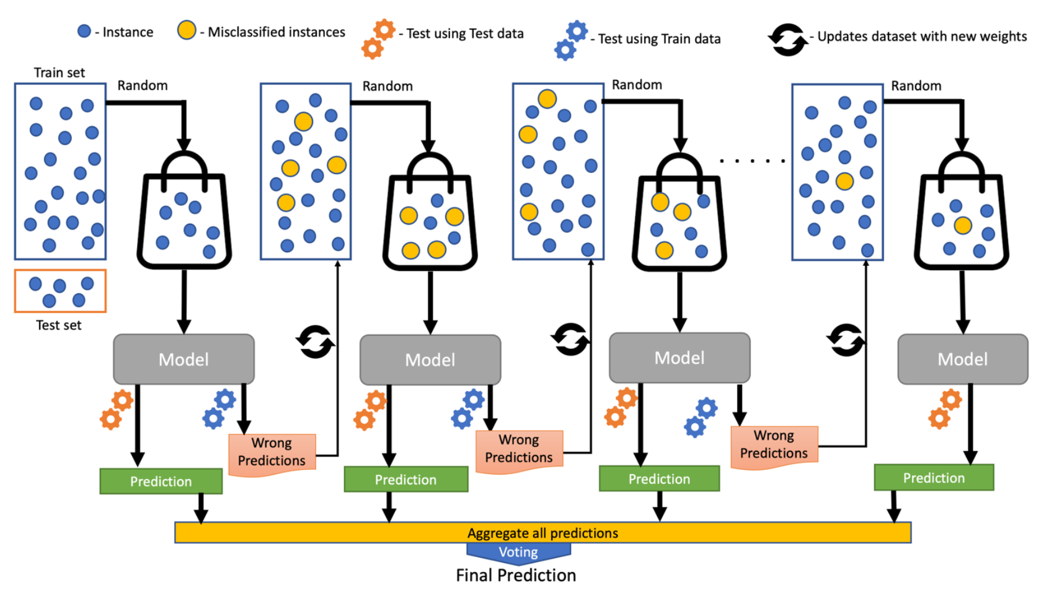

Slide 7
LG BOOSTING(LIGHT GRADIENT BOOSTING)
Unlike XGBoost, which grows trees level by level, LightGBM grows the tree "leaf-wise.“
It picks the specific leaf that will reduce the most error and splits it first, making it much more efficient and often more accurate.
Key innovations like Gradient-based One-Side Sampling (GOSS), histogram-based algorithms and leaf-wise tree growth enable LightGBM to outperform other frameworks in both speed and accuracy.

Slide 8
